Slide 1

Getting Started: Prep and Process for Lead hazard control
Bill Gethard, NJ Lead institute trainer/mentor
Peter Rose, Managing Director

Slide 2
Purpose of this Workshop
Provide new LCMs and Agencies with knowledge on the Best Practices for lead testing and remediation.
Provide a practical guide to the steps needed to successfully deliver lead testing, lead remediations and clearances.
Get lead field staff ready to deliver exceptional lead safe services to families in their community.

Slide 3
What’s First?
Home Visit: Use using lead test swabs or spray to determine if LBP is present.
  Test several, but not all surfaces.
  Take photos!
If lead is found, then complete Application Process.
Once customer is “qualified”, order Lead Risk Assessment (LIRA)

Slide 4
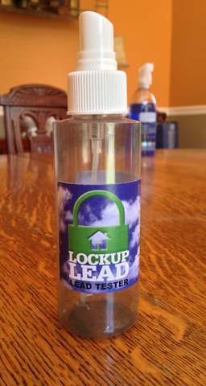
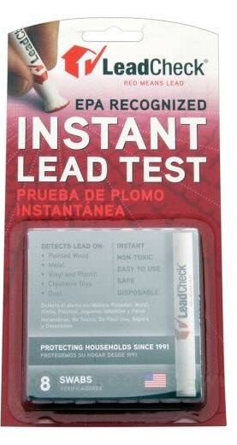
Assessing Homes for Lead
Home visiting teams, weatherization staff or other home visitors
Provides initial assessment for lead using lead swabs or spray (lock up lead) on deteriorated paint.
Provide resident education on healthy homes.
Start application process with owner or resident.

Slide 5
What’s Next?
Lead Work Process Overview
Order a Lead Inspection Risk Assessment (LIRA)
Create a Scope of Work
Select a Contractor
Inspect the unit with the Lead Contractor
Start Lead Hazard Control Work
Monitor Quality of Lead Work
Final inspection and performing a Lead Clearance

Slide 6
What is a lead inspection risk assessment (LIRA)?
A Lead Risk Assessment is an on-site investigation to determine the presence, type, severity, and location of lead-based paint hazards (including lead hazards in paint, dust, and soil) and suggests ways to control them.
A LIRA provide information about LBP hazards through 3 methods:
  XRF inspection of all friction/impact surfaces (and other deteriorated paint surfaces) in every interior rooms and some exterior surfaces
  Dust samples taken from 8 rooms. Focus on children’s rooms of common rooms where children spend time.
  Visual notations about the paint surface, either deteriorated or intact. This determination can change what measures are needed.

Slide 7
What is a lead inspection risk assessment (LIRA)?
Floor plan drawing of each room with walls and windows noted for each room.
A LIRA determines what measures will be applied to surfaces with ”lead hazards”.
A LIRA informs your Scope of Work (SOW) for the Unit.
Each LIRA should look similar. This assists in writing a SOW.
Notes:
We will flip to a .pdf of an actual LIRA and walk through each section.

Slide 8
How to order a lira?
Request a LIRA by first setting up an appointment with the customer/resident.
Use the list of pre-screened Lead Evaluation Contractors to pick one that works in your area. Use if they are available. Tell them you are requesting a LIRA for the DCA Lead Assistance Program.
Doing more than one at a time is preferable. Each takes about an hour, depending on the size of the unit.
If not available go to the next one. Try to use equally.

Slide 9
What is a Scope of Work?
A Scope of Work describes the exact nature of all work to be done in a Line Item by Line Item fashion.
It follows the LIRA
It includes other health and safety issues that are found during the walkthroughs (mold, loose hand rails, dangerously damaged flooring, etc.)
SOWs are given to contractors for them to add pricing
LCMs and Contractors negotiate as needed on prices per Cost Guideline document.
Notes:
Will show a .pdf of a sample SOW. Key thing to discuss 1) LCM writes all SOWs. Contractors fill in pricing only. 2) must include ALL hazards on the LIRA. 3) can include additional H&S

Slide 10
Contractor Selection
Contractors are selected after the job specifications are known from LCM walkthrough and LIRA.
Agencies can use Bid or Round Robin method of contractor selection.
Refer to DCA contractor Bid Rules if using.
Recommend Round Robin.

Slide 11
Contractor Round Robin Process Summary
Contractors are part of a pool of contractors from which they will be chosen for each lead job based on capacity, skill and availability. Our goal is to distribute jobs equitably based on the skills and abilities of each contracting company.
After LCM has idea of size of job based on walkthrough of unit with Lead Evaluator, a Contractor is chosen out of the pool. Contractor size, skill and ability must match the job.
Contractor then will be required to do walkthrough of unit with LCM.
LCM will provide Contractor with Scope of Work with items listed, but no costs. The LCM is available to discuss the write-up and cost estimate with Contractor to clarify and negotiate prices.
Contractor and LCM will agree to final Scope of Work costs. Change Orders are rarely given.
Once accepted, contractor will be awarded the project for the amount of the final cost estimate approved by the Lead Construction Manager or Lead Program Manager.
Once an eligible contractor is awarded a property, that firm will not be offered another unit until the remaining contractors are given an opportunity to participate, if possible. This will repeat until all contractors have been offered an opportunity to be awarded a contract. Once exhausted, a new lottery cycle will begin.
Notes:
Need a robutst contractor pool. Mix of abatement and remediation, but mostly remediation contractors (i.e. RRP Firm Certified) with experience and good reviews.

Slide 12
Starting lead work
Award bid. Consider giving contractors 25%-50% of job up front. Helps smaller contractors with cash flow.
LCM or Agency coordinates job start with resident and contractor. Contractor should give idea of time to completion.
LCM should attend set-up (is containment correct?), speak with the owner/resident and make sure things are started correctly.
LCM is the GC. Responsible for making sure things work in all aspects from start to finish.
Notes:
Oversight is important, especially with new contractors, but all need to be watched and coached.

Slide 13
Monitoring Lead Contractors
Visit site during work, to monitor and give any corrections.
Must visit prior to Clearance to ensure all work is done per SOW, meets standards and unit is cleaned properly.
Get completion timeline from Contractor, so Clearance can be arranged.

Slide 14
Final Inspections and Lead Clearance
Once the completion time is known, Clearance can be ordered no sooner than 1 hour after cleaning.
Call Lead Evaluation company from list to schedule. Can be same or different that one that did LIRA.
Give them the SOW, so they will know work areas. Dust samples must be collected in every work area.
Clearance report is due to you within 72 hours.

Slide 15
Agency hires a Lead Construction Manager (LCM) to guide lead remediation/abatement process.
Lead Construction Manager begins process by scheduling a Lead Risk Assessment. Evaluators are chosen from pool of Evaluators provided by Isles. LCM coorindinates LIRA with resident, LCM and Lead Evaluator.
The Lead Inspection/Risk Assessment will be provided in a standardized report form that will be returned to LCM within specified time. Cost of LIRA is paid by Isles.
LCM attends Risk Assessment and does walkthrough of unit with Lead Risk Assessor. Takes notes and pictures of the unit that will assist with creating Scope of Work.
LCM receives LIRA and creates Scope of Work with with all lead hazards listed. LCM adds ancillary health and safety/causative factors for lead measures.
LCM coordinates with Contractor as job nears completion, schedules the Clearance examination with Lead Evaluation firm at least 1 hour after final cleaning.
If unit fails Clearance, LCM schedules additional cleaning and new clearance. Contractors are responsble for clearance costs after 2nd clearance.
Once unit is cleared , clearance report is added to Field file and returned to office staff.
Office staff adds measures to invoice. DCA Monitor sign-off is required prior to Invoice being submitted and SAGE FSR compiled.
Contractor returns SOW with costs filled in. LCM negotiates (if needed) final job cost that comply with Cost Guidelines. Signs SOW. Schedules work and provides guidance on job setup, lead measures performed and proper cleaning.
Using Round Robin process, LCM schedules contractor walthrough of job. LCM provides Contractor w/guidance on issues Identified. SOW can be given before or after walthrough pre-filled with measures, but no costs.

Slide 16

Questions?

Slide 17
Next steps
You will need:
  A Lead Construction Manager
  A Contractor Pool
  Qualified applicants
PPT will be uploaded on NJ Lead Institute website as will the following docs.
  Sample SOW and template for your use
  Sample LIRA
  Cost Guidelines

Slide 18
Next steps
We will be doing some ”How to” videos soon.
  Initial testing for lead
  Walk through with LCM and lead evaluator
  Final walkthrough and clearance
Email Bill and me when you schedule your first LIRA.
Will provide assistance preparing first few Scopes of Work.

