Slide 1

Lead hazard control basics for lead construction managers
Bill Gethard, NJ Lead institute trainer/mentor
Peter Rose, Managing Director

Slide 2
AGENDA FOR TODAY
Remediation vs Abatement
Lead Hazard Control Process Overview
Lead Inspection Risk Assessments (LIRA)
Your Role in Lead Inspection Risk Assessments
Writing Scopes of Work for Remediations and Abatements
Contractor Selection and Pricing Scopes of Work
Your Role in Monitoring Lead work
Finalizing the job: lead clearance

Slide 3
First Things First
Question #1: What critical questions do you want answered during this workshop?
Poll #1: What is the difference between a Remediation and an Abatement?

Slide 4
Remediation vs abatement
An Abatement is a lead hazard control job where a child has been identified with an elevated blood lead level above the state standard.
Abatements are jobs where the owner have received a Notice of Violation from the local municipal health official.
Abatements use special contractors, need permits, have special work and relocation requirements.
The local health official determines what work is done and when the unit is cleared for re-occupancy.
Notes:
The NOV is basically a LIRA done by the local health official. However, if it doesn’t have a dust samples, a drawing of the unit, visual descriptions and needed measures, you need to order a 3rd party LIRA from the Statewide pool.

Slide 5
Remediations vs abatements
A (lead) Remediation is any other lead hazard control job where lead-based paint and lead dust is present in a home.
Remediations can be done with EPA RRP Firm certified contractors who have a lead “Renovator” on the job.
Remediations fall under NJ/EPA/HUD guidelines for controlling or eliminating lead-based paint and dust.

Slide 6
Lead Work Process Overview
Order a Lead Inspection Risk Assessment (LIRA)
Create a Scope of Work
Select a Contractor
Inspect the unit with the Lead Contractor
Start Lead Hazard Control Work
Monitor Quality of Lead Work
Final inspection and performing a Lead Clearance

Slide 7
What is a lead inspection risk assessment (LIRA)?
A Lead Risk Assessment is an on-site investigation to determine the presence, type, severity, and location of lead-based paint hazards (including lead hazards in paint, dust, and soil) and suggests ways to control them.
A LIRA provide information about LBP hazards through 3 methods:
  XRF inspection of all friction/impact surfaces (and other deteriorated paint surfaces) in every interior rooms and some exterior surfaces
  Dust samples taken from 8 rooms. Focus on children’s rooms or common rooms where children spend time.
  Visual notations about the paint surface, either deteriorated or intact. This determination can change what measures are needed.

Slide 8
What You will get in a lira
Floor plan drawing of each room with walls and windows noted for each room.
A LIRA determines what measures will be applied to surfaces with ”lead hazards”.
Friction/impact surfaces require very different measures.
A LIRA informs your Scope of Work (SOW) for the Unit.
Each LIRA should look similar. This assists in writing a SOW.
Notes:
Discuss how LIRA might not have every window for rooms with multiple windows on a wall.
Discuss how LCMs must read the LIRA measure suggested but make sure the measure is correct. Evaluators make mistakes or cut corners.
Look a Measures List

Slide 9
How to order a lira?
Request a LIRA by first setting up an appointment with the customer/resident.
Use the list of pre-screened Lead Evaluation Contractors to pick one that works in your area. Use if they are available. Tell them you are requesting a LIRA for the DCA Lead Assistance Program.

Slide 10
DISCUSSION ABOUT LIRAS
Make sure that the LIRA is accurate; address, pictures.
Make sure the count of windows and doors is correct.
The LCM has control over the methods for the treatment of all surfaces. For example, just because the Evaluator says to wet scrape and repaint, the LCM can say replace that item and vice-versa.
Take pictures of all projects for reference. This way you know the conditions of the home before work begins.

Slide 11
What is a Scope of Work?
A Scope of Work describes the exact nature of all work to be done in a Line Item by Line Item fashion.
It is completed by your Agency’s LCM, NOT the contractor.
It follows the LIRA
It includes health and safety issues that are found during the walkthroughs (mold, loose handrails, dangerously damaged flooring, etc.)
SOWs are given to contractors for them to add pricing
LCMs and Contractors negotiate as needed on prices per Cost Guideline document.
Notes:
Will show a .pdf of a sample SOW. Key thing to discuss 1) LCM writes all SOWs. Contractors fill in pricing only. 2) must include ALL hazards on the LIRA. 3) can include additional H&S

Slide 12
Scopes of work
Question: What issues are you having with developing Scopes of Work. Put your issues in the chat.
What if Contractors are putting in prices that are too high?
What counts as an “ancillary issue”?
What things can’t be in an SOW?
Can I accept a SOW with a high disposal fee bc it’s lead?
Bill, add any items from what you are seeing in the field for discussion, pro tips or education.

Slide 13
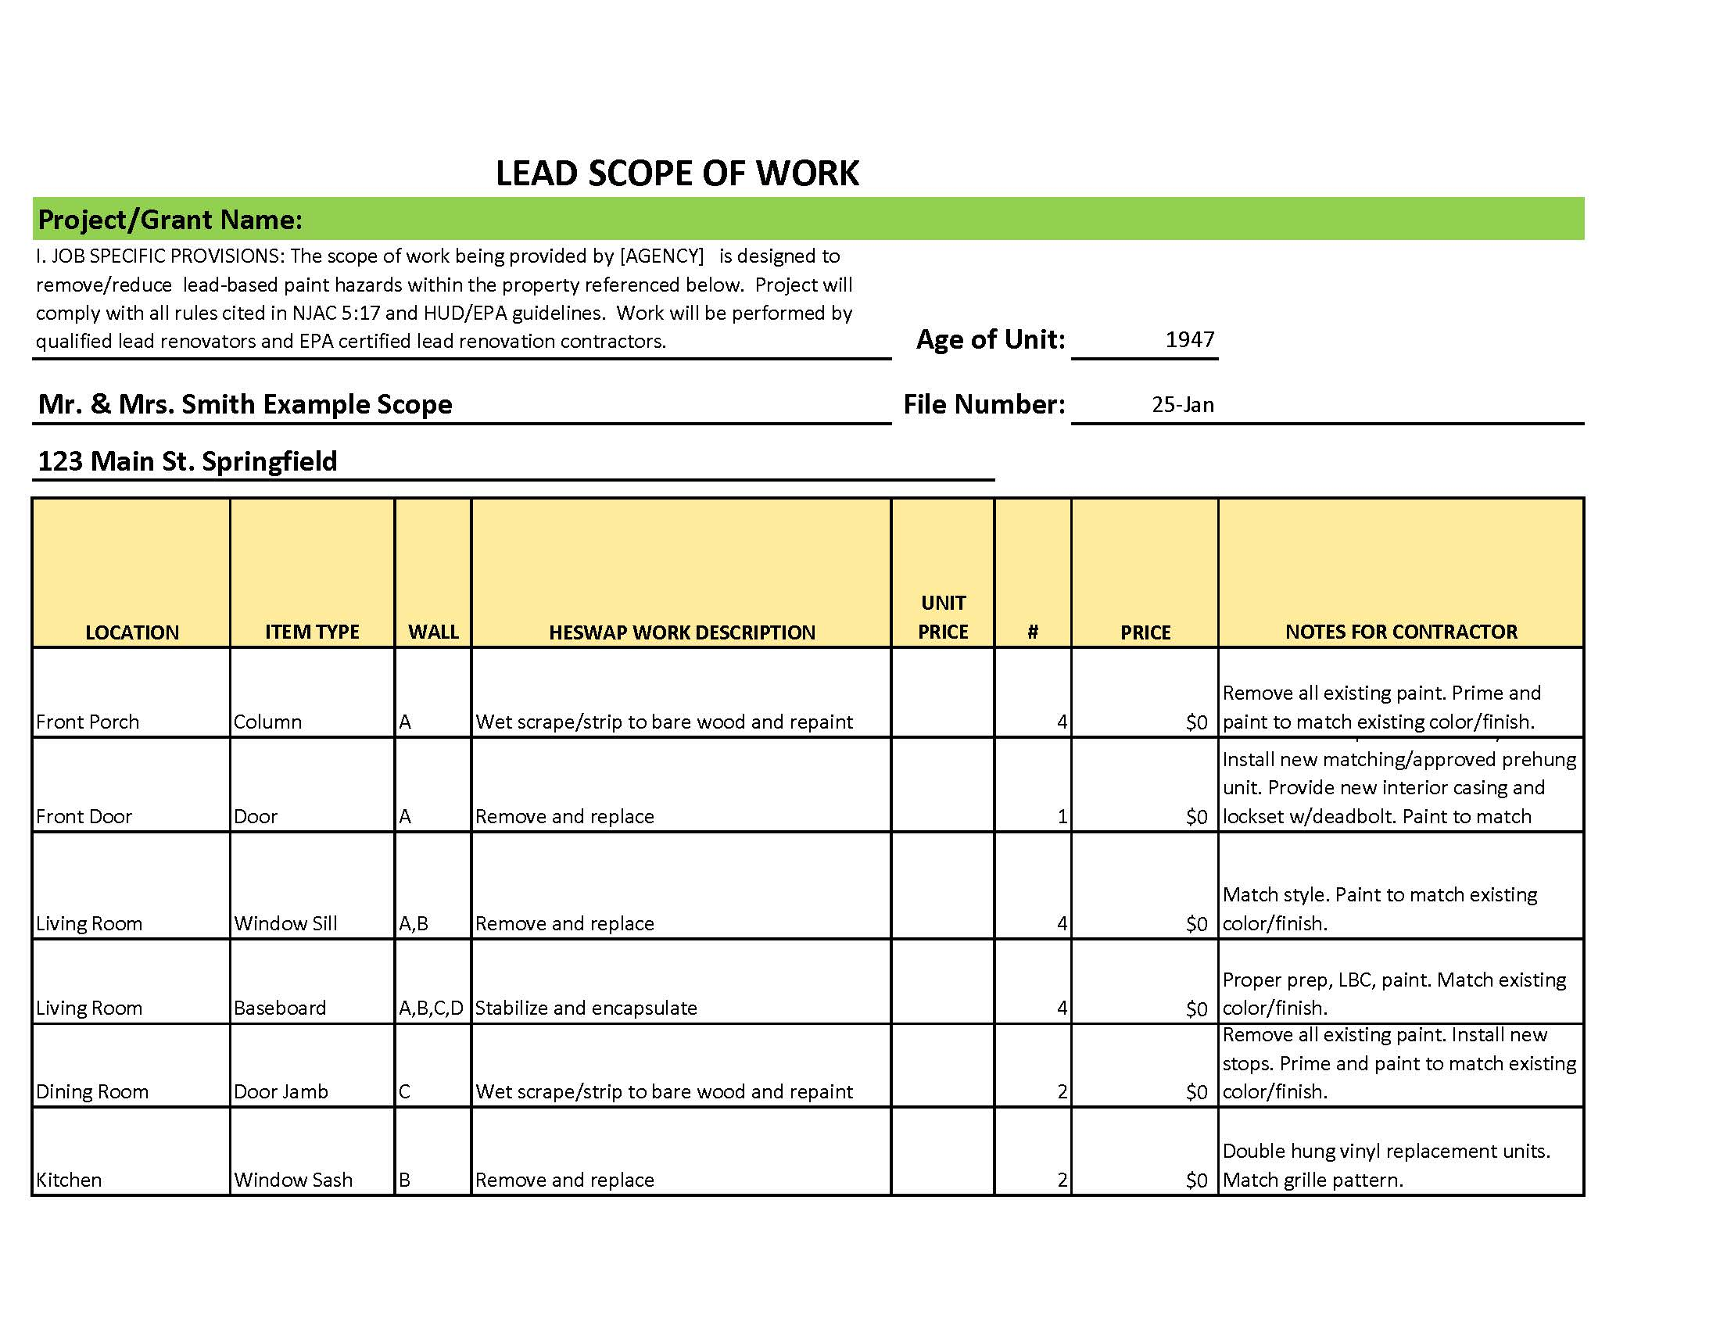

Slide 14
Contractor Selection
Contractors are selected after the job specifications are known from LCM walkthrough and LIRA. Not all Contractors are created equal.
Agencies can use Bid or Round Robin method of contractor selection.
Refer to DCA contractor Bid Rules if using.
Recommend Round Robin.

Slide 15
Contractor Round Robin Process Summary
Contractors are part of a pool of contractors from which they will be chosen for each lead job based on capacity, skill and availability. Our goal is to distribute jobs equitably based on the skills and abilities of each contracting company.
After LCM has idea of size of job based on walkthrough of unit with Lead Evaluator, a Contractor is chosen out of the pool. Contractor size, skill and ability must match the job.
Contractor then will be required to do walkthrough of unit with LCM.
LCM will provide Contractor with Scope of Work with items listed, but no costs. The LCM is available to discuss the write-up and cost estimate with Contractor to clarify and negotiate prices.
Contractor and LCM will agree to final Scope of Work costs. Change Orders are rarely given.
Once accepted, contractor will be awarded the project for the amount of the final cost estimate approved by the Lead Construction Manager or Lead Program Manager.
Once an eligible contractor is awarded a property, that firm will not be offered another unit until the remaining contractors are given an opportunity to participate, if possible. This will repeat until all contractors have been offered an opportunity to be awarded a contract. Once exhausted, a new lottery cycle will begin.
Notes:
Need a robutst contractor pool. Mix of abatement and remediation, but mostly remediation contractors (i.e. RRP Firm Certified) with experience and good reviews.

Slide 16
Starting lead work
Award bid. Consider giving contractors 25%-50% of job up front. Helps smaller contractors with cash flow.
LCM or Agency coordinates job start with resident and contractor. Contractor should give idea of time to completion and put it on the SOW.
LCM should attend set-up (is containment correct?), speak with the owner/resident and make sure things are started correctly.
LCM is the GC. Responsible for making sure things work in all aspects from start to finish.
Notes:
Oversight is important, especially with new contractors, but all need to be watched and coached.

Slide 17
Monitoring Lead Contractors
Poll #3: Who is responsible for monitoring lead work?
Visit site during work, to monitor and give any corrections.
Must visit prior to Clearance to ensure all work is done per SOW, meets standards and unit is cleaned properly.
Get completion timeline from Contractor, so Clearance can be arranged.
Contractors do not order Clearances. Only LCM or agency can order Clearances.

Slide 18
Final Inspections and Lead Clearance
Once the completion time is known, Clearance can be ordered no sooner than 1 hour after cleaning.
Call Lead Evaluation company from list to schedule. Can be same or different than one that did LIRA.
Give them the SOW, so they will know work areas. Dust samples must be collected in every work area.
Clearance report is due to you within 72 hours.

Slide 19
Agency hires a Lead Construction Manager (LCM) to guide lead remediation/abatement process.
Lead Construction Manager begins process by scheduling a Lead Risk Assessment. Evaluators are chosen from pool of Evaluators provided by Isles. LCM coorindinates LIRA with resident, LCM and Lead Evaluator.
The Lead Inspection/Risk Assessment will be provided in a standardized report form that will be returned to LCM within specified time. Cost of LIRA is paid by Isles.
LCM attends Risk Assessment and does walkthrough of unit with Lead Risk Assessor. Takes notes and pictures of the unit that will assist with creating Scope of Work.
LCM receives LIRA and creates Scope of Work with with all lead hazards listed. LCM adds ancillary health and safety/causative factors for lead measures.
LCM coordinates with Contractor as job nears completion, schedules the Clearance examination with Lead Evaluation firm at least 1 hour after final cleaning.
If unit fails Clearance, LCM schedules additional cleaning and new clearance. Contractors are responsble for clearance costs after 2nd clearance.
Once unit is cleared , clearance report is added to Field file and returned to office staff.
Office staff adds measures to invoice. DCA Monitor sign-off is required prior to Invoice being submitted and SAGE FSR compiled.
Contractor returns SOW with costs filled in. LCM negotiates (if needed) final job cost that comply with Cost Guidelines. Signs SOW. Schedules work and provides guidance on job setup, lead measures performed and proper cleaning.
Using Round Robin process, LCM schedules contractor walthrough of job. LCM provides Contractor w/guidance on issues Identified. SOW can be given before or after walthrough pre-filled with measures, but no costs.

Slide 20

Questions?

Slide 21
Next steps
Have you downloaded the:
  DCA Policy and Procedure Manual
  NJAC 5:17 and NJ 8:51
  HUD Guidelines
  LCM Best Practices - NEW
  Suggested Measures - NEW
We will provide assistance with:
  Scheduling and performing LIRAs
  Preparing first few Scopes of Work
  Starting lead hazard control jobs

